Slide 1

Spotlighting under-the-radar performers in college women’s volleyball
Scott Powers
Assistant Professor, Sport Analytics, Statistics

Slide 2


Background
Data Volley
Developed in Italy in early 2000s
Charts location, quality of touches
Brigham Young University
Carl McGown
Men’s volleyball coach 1990-2002
Gil Fellingham
Statistics professor 1990-present
Published 4 volleyball papers in JQAS
“Carl pioneered the application of scientific rigor to the way we coach our sports.” –Hugh McCutcheon

Slide 3

Background, continued
Volleymetrics
Est. 2014; acquired by Hudl 2017
Multiple speakers at SSAC 2017
Founder Giuseppe Vinci (BYU 2008-2015)
Corley Bagley & Brett Ware research paper
volleydork.com (Chad Gordon)
Calculates “Expected Value Added”

Slide 4


Collaborators
Luke Stancil
Student Manager, Rice Volleyball
B.A. Computational & Applied Mathematics and Economics expected 2024
@ SSAC for Startup Competition!
Naomi Consiglio
Student Manager, Rice Volleyball
Sport Head (Volleyball), Rice Sport Analytics Team
B.A. Statistics and Sport Analytics expected 2025

Slide 5
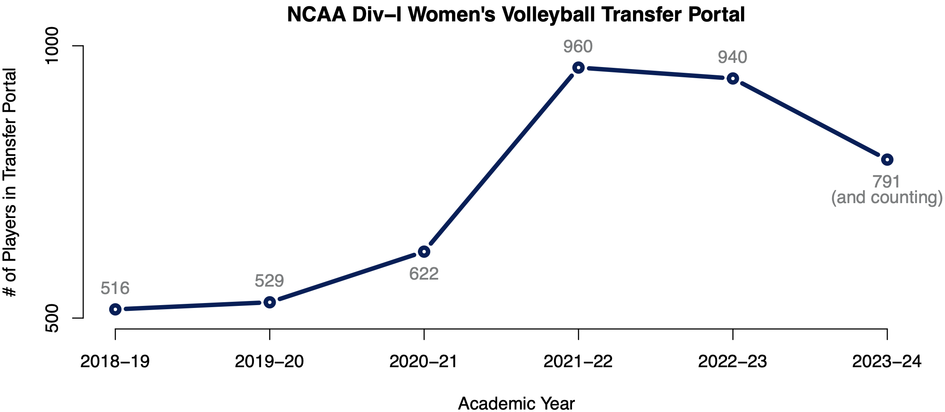
The Problem
With 6,000 players across Div-I (and 1,000 in the transfer portal), how can we highlight standout performers, particularly those from smaller conferences?

Slide 6
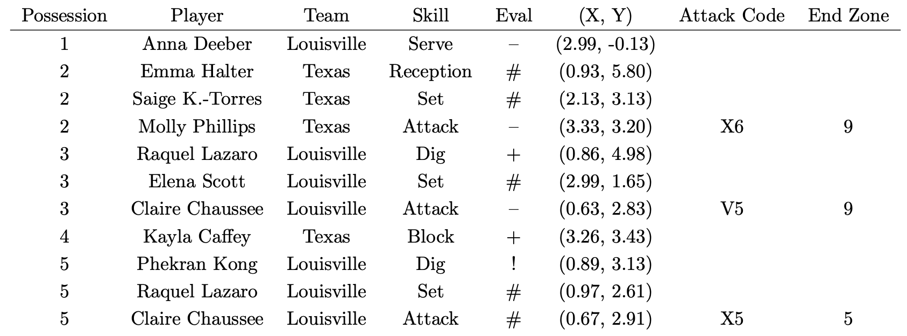
The Data
4,147 matches from 2022 NCAA Division I season
600,000+ points and 5,000,000+ touches
Sample data from first point of 2022 NCAA National Championship match

Slide 7
The Approach
Estimate point win probability model using Markov chain
State: sequence of touches (including quality) during current “possession”
Win probability updates as each touch occurs
Aggregate changes in win probability due to players’ touches
Serve, Receive, Set, Attack, Block, Dig all measured in units of points
Estimate strength of schedule using hierarchical linear model
Players are nested within teams; teams are nested within conferences
Strength of schedule for each touch depends on specific players involved

Slide 8
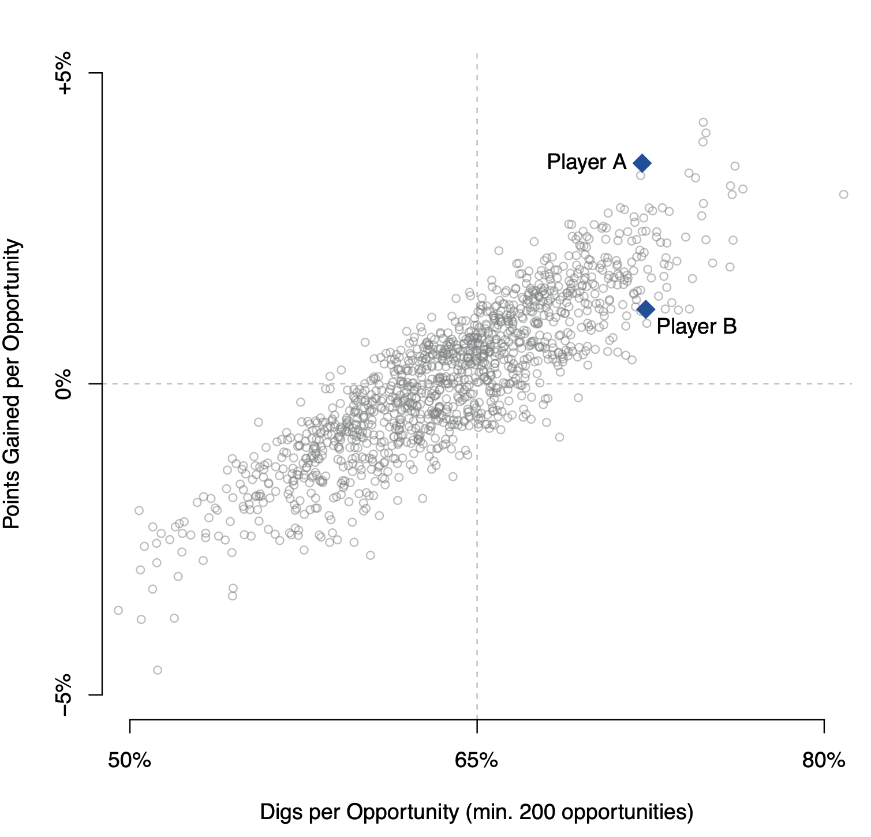
The Results: Points Gained
Digs per opportunity
Player A: 72%
Player B: 72%
Points Gained per opportunity
Player A: +3.6%
85% no block touch, 48% perfect dig
Player B: +1.2%
66% no block touch, 36% perfect dig

Slide 9
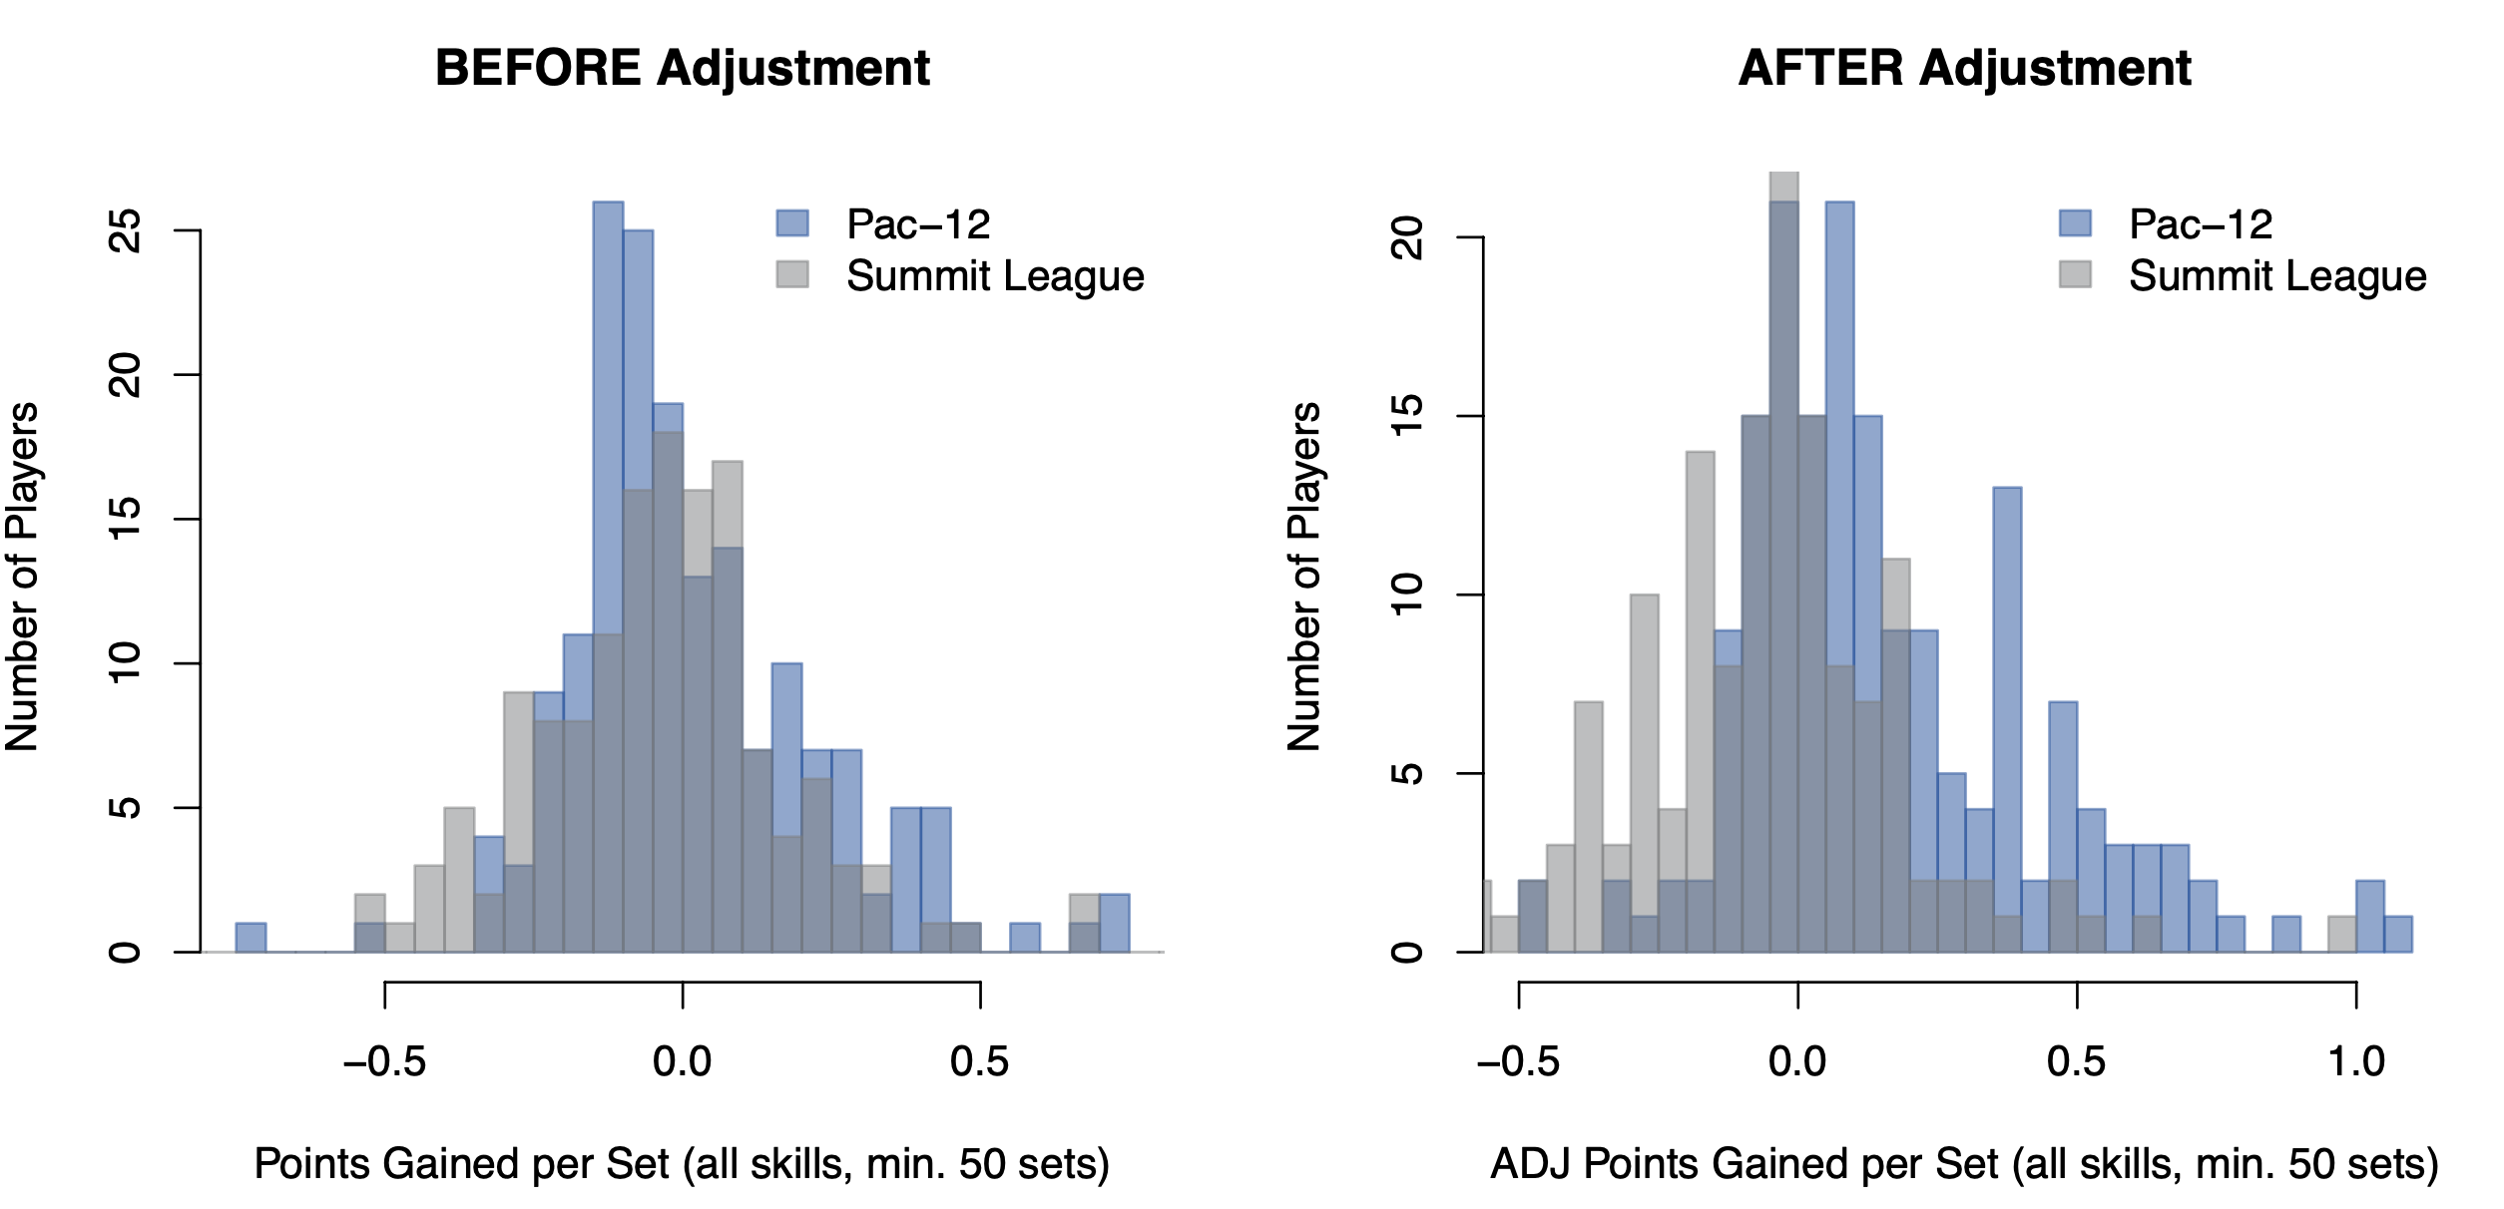
The Results: Strength of Schedule
Comparison of Pac-12 and Summit League player performances before and after strength-of-schedule adjustment.

Slide 10
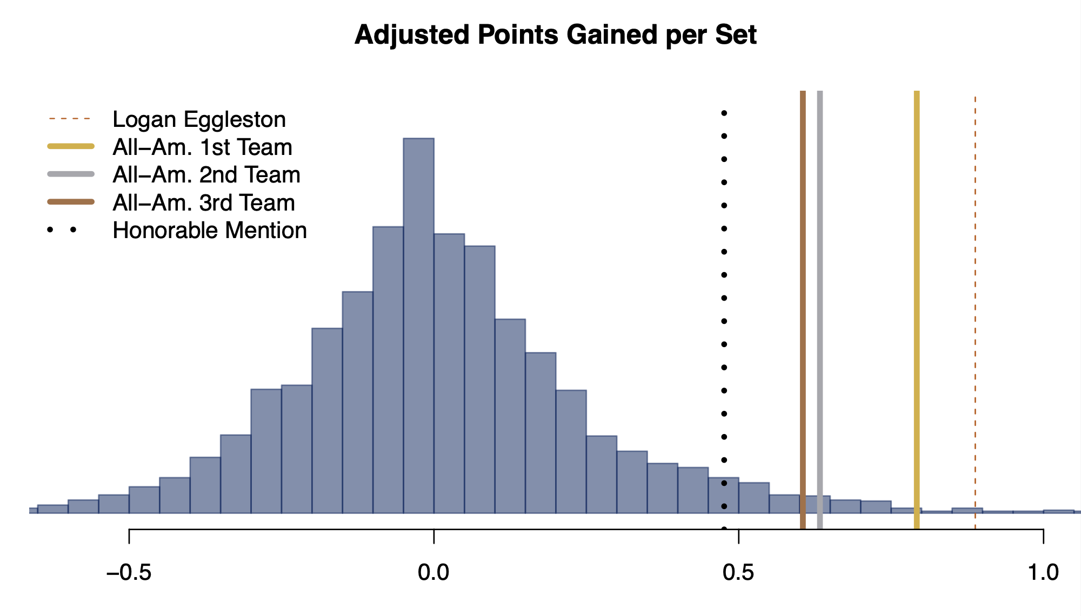
The Results: SoS-Adjusted Points Gained
Distribution of adjusted Points Gained per set for all NCAA players (minimum 50 sets played).

Slide 11












The Standouts
Opposite Hitters
Callie Martin* +0.71
Gabby Waden +0.62
Outside Hitters
Jess Mruzik‡* +0.96
Bianca Bertolino* +0.87
Gabby Gonzales‡* +0.85
Kenna Sauer‡ +0.84
Middle Blockers
Leyla Blackwell +0.63
Rylee Rader +0.58
Kaitlyn Hord +0.57
Rachel Langs +0.57
Setters
Melani Shaffmaster +0.86
Amber Olson +0.75
Liberos
Hannah Grant +0.79
Yelianiz Torres‡* +0.78
Top performances (adj. Points Gained per set) w/o 2022 All-America recognition
‡ Player transferred between 2022 and 2023
* Player earned 2023 All-America recognition

Slide 12


The Future
Pro Volleyball Federation
Launched January 2024
1st match set attendance record in pro women’s volleyball (11,624)
Atlanta, Columbus, Grand Rapids, Omaha, Orlando, San Diego, Vegas
League One Volleyball
Set to launch November 2024
Atlanta, Austin, Houston, Madison, Omaha, Salt Lake

Slide 13
The Takeaways
Volleyball lends itself very well to statistical analysis
There is A LOT of information that is not in the box score
Outside hitters are easiest to evaluate; setters are hardest
Outside hitters dominate the Points Gained leaderboard
Top middle blockers accumulate less PG per set but more PG per point
Blocker responsible for 52% of attack outcome, even when no block touch
Results largely align with subjective evaluation by coaches
BUT we also spotlight some players not recognized by All-America awards

Slide 14
Thank you!
Find the details of this and other work on my website: saberpowers.github.io

